Slide 1
CMIL-project meeting
11th Feb 2025

Slide 2
Status update
Project status can be seen on the project website:
We matched tissue slices based on the shape of the epithelium across the three stains – H&E, melan-A, and sox-10, for all the 107 cases
The folder with the slices has been shared with you (26th Jan 2025), with case numbers as mentioned in the shared spreadsheet.
The matching status of each slice can be seen here
Questions:
Should we prioritize the 84 slices that have matches for annotation?
Which and how many slices should be annotated and provided to us for model training, and the rest used as test data?
There are some Liverpool cases highlighted in yellow. Is there anything different about them?

Slide 3
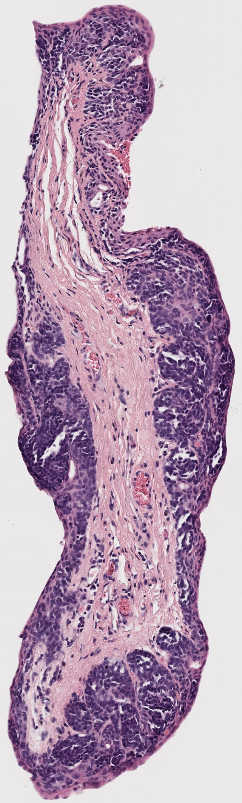
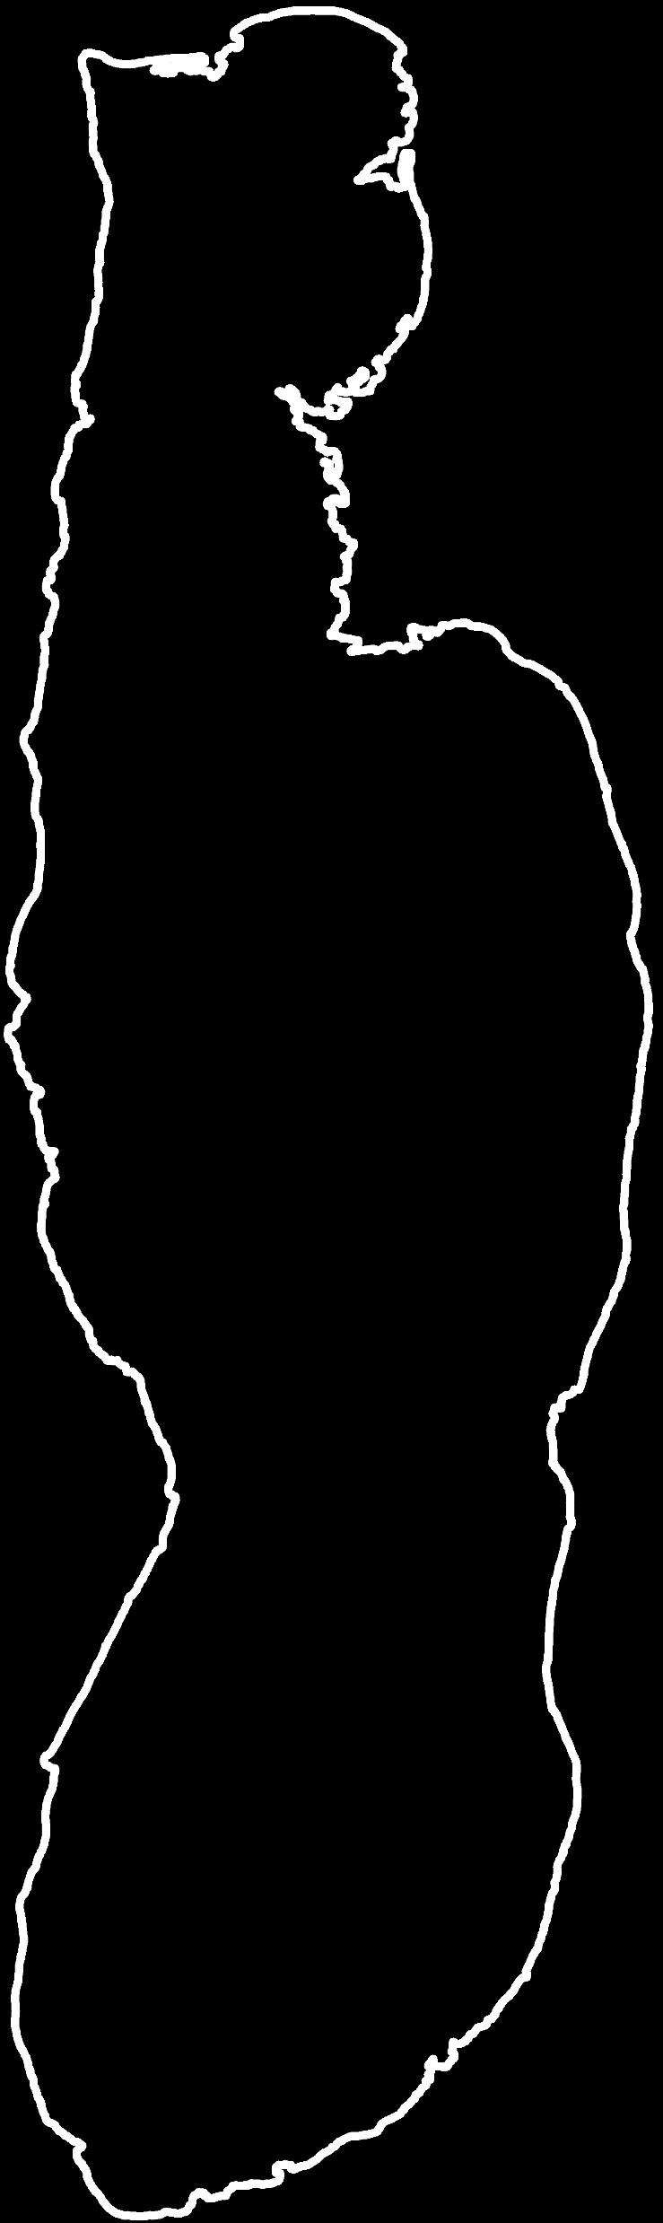
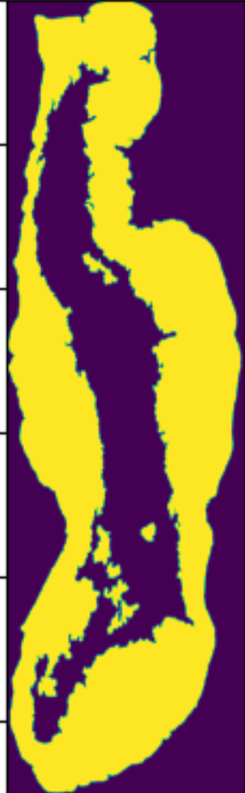
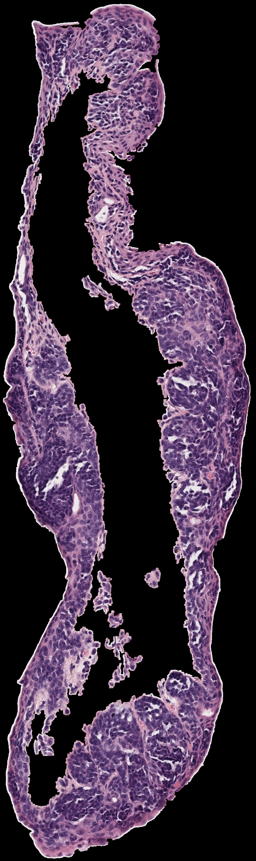
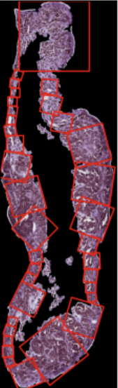
Patching algorithm: update
Tissue slice
Largest contour
Tangent along the contour
Get the width perpendicular to the tangent
Make the patch
Keep making patches around the contour

Slide 4
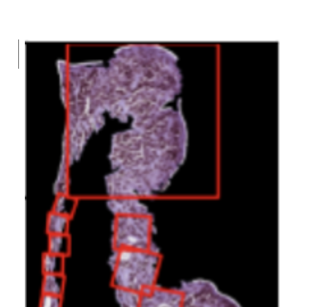
Patching algorithm: update
Currently, we are updating the algorithm to:
Make patches on the epithelium within the stroma
Fix inappropriate patch size in some cases

Slide 5
Slices extracted
Medical aspect questions
Why would the ML model needs a patch that includes the entire width of the epithelium, as the ML model may learn patterns to classify the patch without being informed of the location of the melanocytes? Was the entire width necessary for the doctors, but may not be necessary for the ML model? Brown vs purple melanocytes in paper.
ML questions
If two opposite corners of the patch are outside the epithelium, will it be an acceptable patch? This will lead to width of the epithelium being along the diagonal of the patch - will our model be able to identify that?

Slide 6
Questions on patching
Medical aspect questions
Why would the ML model needs a patch that includes the entire width of the epithelium, as the ML model may learn patterns to classify the patch without being informed of the location of the melanocytes? Was the entire width necessary for the doctors, but may not be necessary for the ML model? Brown vs purple melanocytes in paper.
ML questions
If two opposite corners of the patch are outside the epithelium, will it be an acceptable patch? This will lead to width of the epithelium being along the diagonal of the patch - will our model be able to identify that?

